Slide 1

USACE National Structures Inventory
Geospatial CoP Meeting
Randy Goss
Research Geographer
ERDC-CRREL
Date: June 2019

Slide 2
$37,428,732,318,097

Slide 3
What is the nsi?
The National Structure Inventory (NSI) is a system of databases containing structure inventories of varying quality and spatial coverage

Slide 4
USACE NSI
USACE-Developed NSI Base Data
consistent set of data for analysis across the portfolio of USACE structures

Slide 5
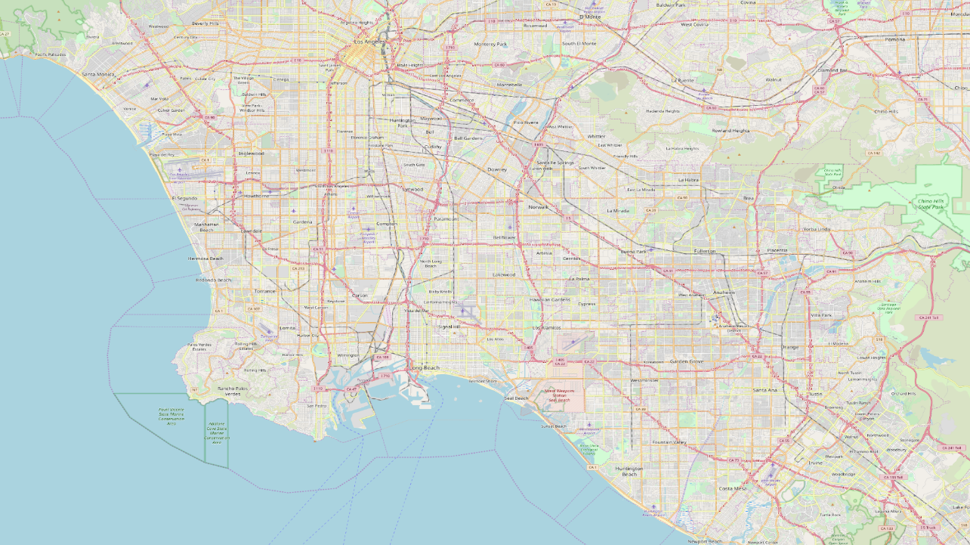
Show a simple map of structures

Slide 6
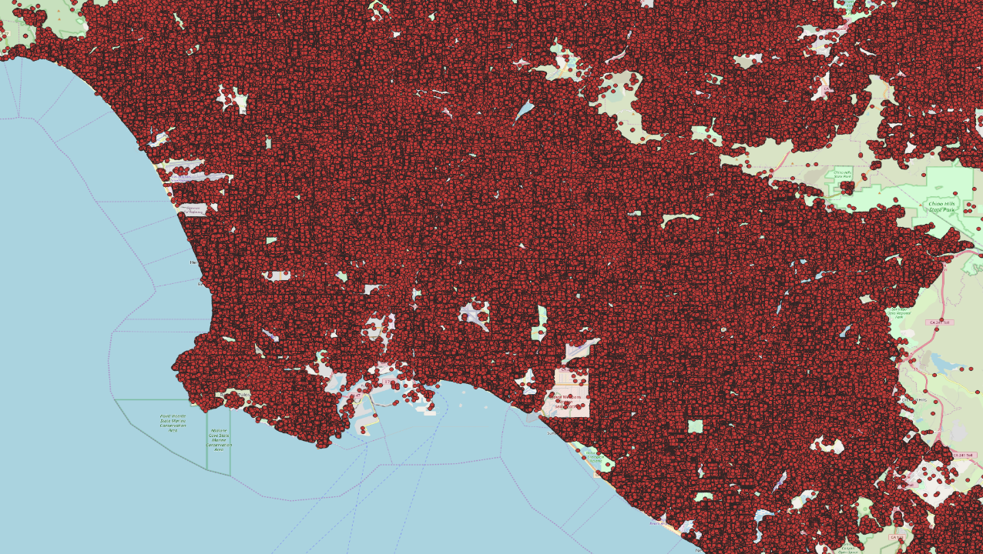
Show a simple map of structures

Slide 7
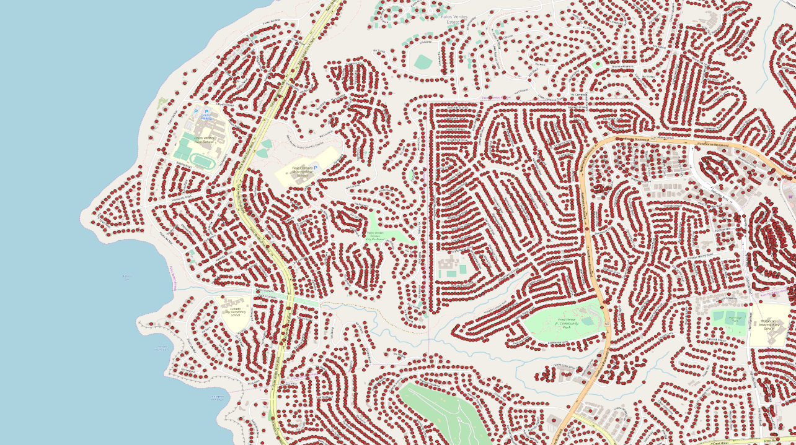
Show a simple map of structures

Slide 8
USACE NSI
IMPORTANT
USACE-Developed NSI Base Data cannot be shared outside of the federal government

Slide 9
Why?
Assessment and analysis of natural hazards
Consequence Estimation
Potential loss of life
Potential economic damage

Slide 10
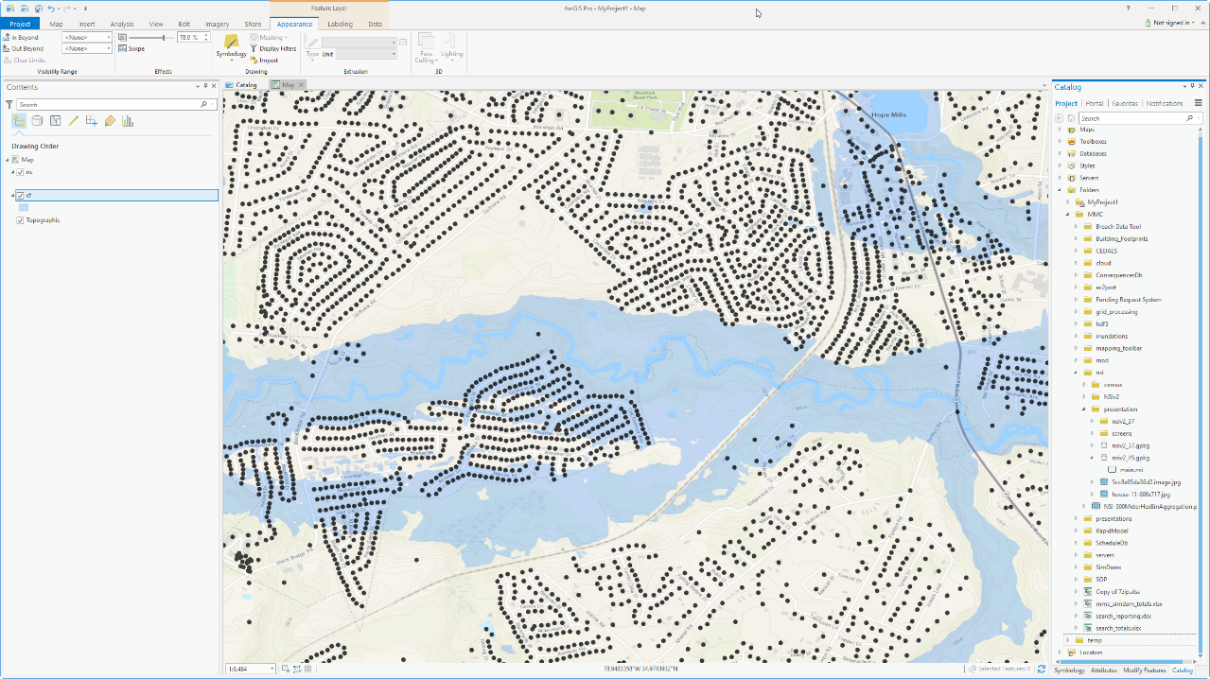
Flood Fights and
EAP Maps!

Slide 11
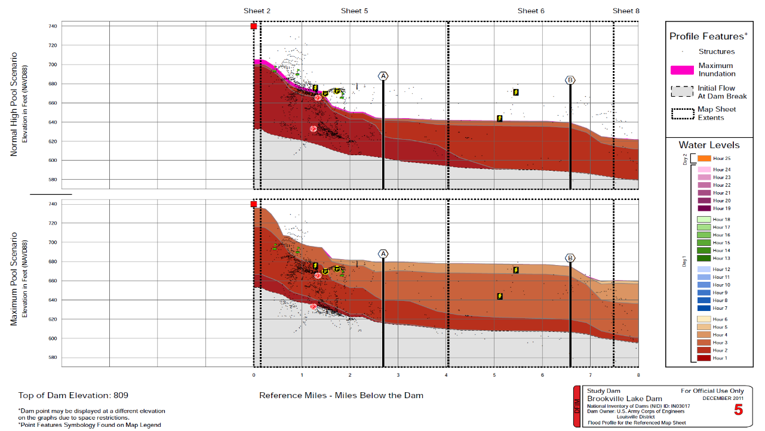
Flood Fights and
EAP Maps!

Slide 12
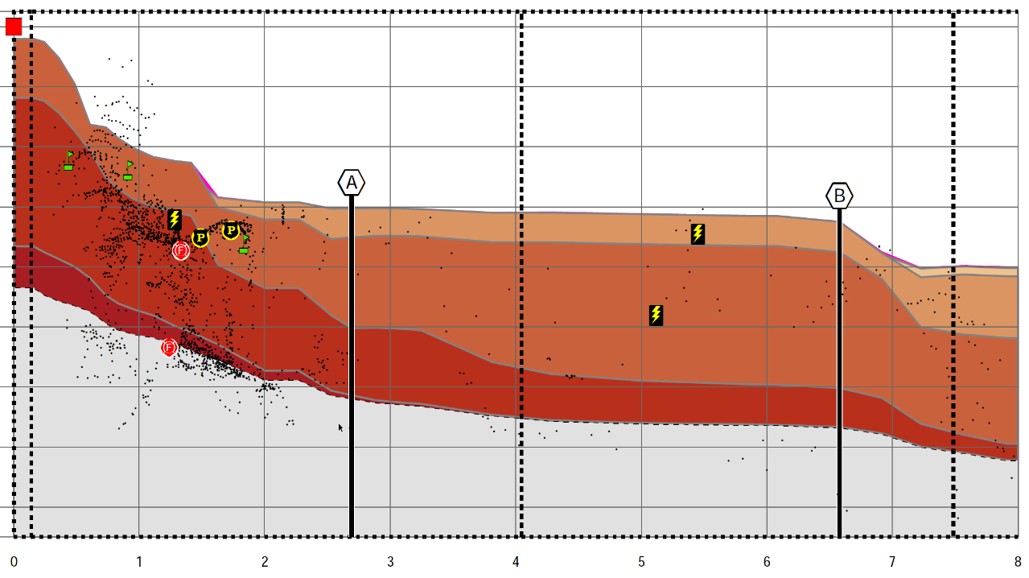
Flood Fights and
EAP Maps!

Slide 13
USACE NSI
Maintained by:
Will Lehman HEC
Nicholas Lutz LRL
Alex Ryan LRL
Tim Smith LRH
Kurt Buchanon LRH
Randy Goss ERDC

Slide 14
Takeaway
The HEC NSI GitHub page is your best source for updated information
https://github.com/HydrologicEngineeringCenter/NSI

Slide 15
History
Initial version was primarily a disaggregation of US Census data
~2016

Slide 16
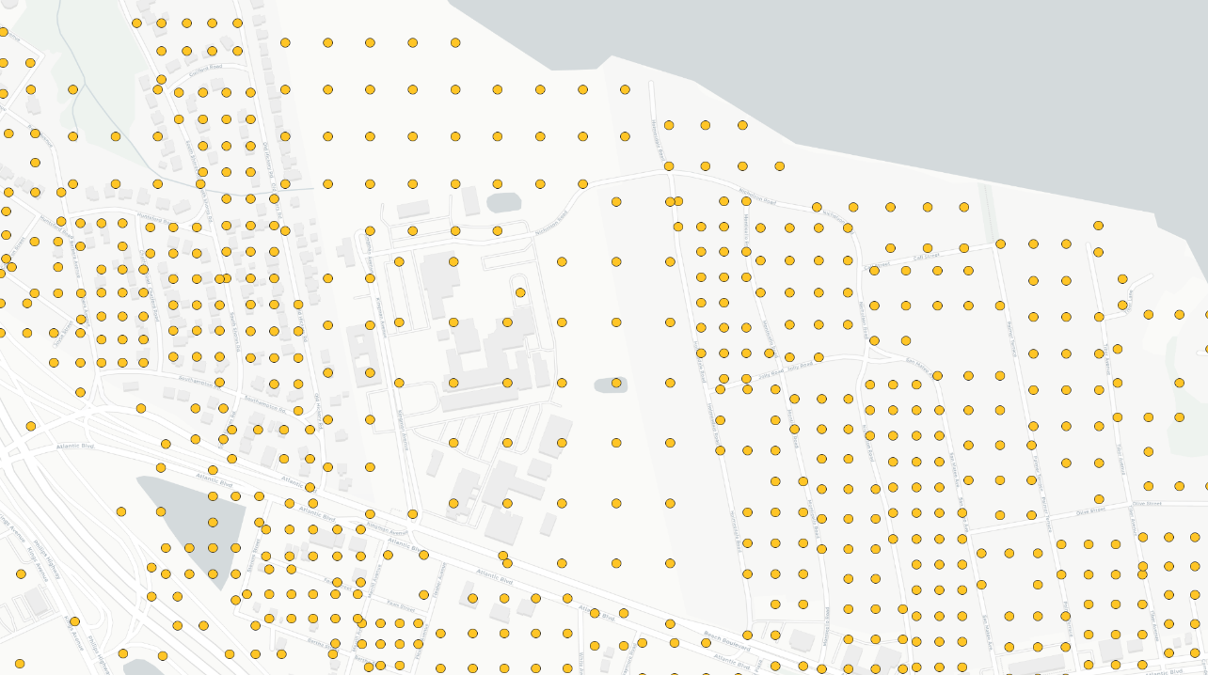
Live data for v1

Slide 17
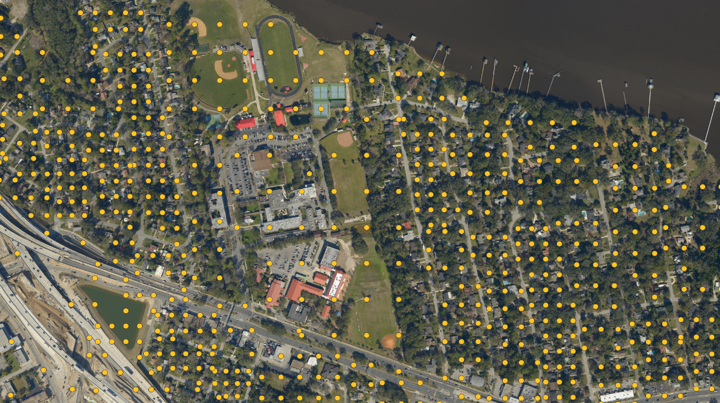
Live data for v2

Slide 18
Version 2
2018/2019
Placements significantly improved
Corelogic Structure Footprint
Microsoft building footprints

Slide 19
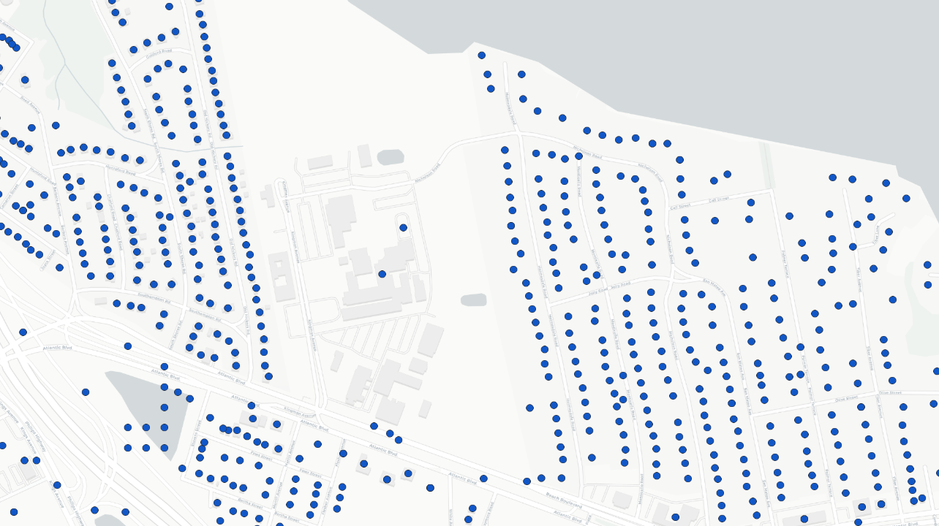
Live data for v1

Slide 20
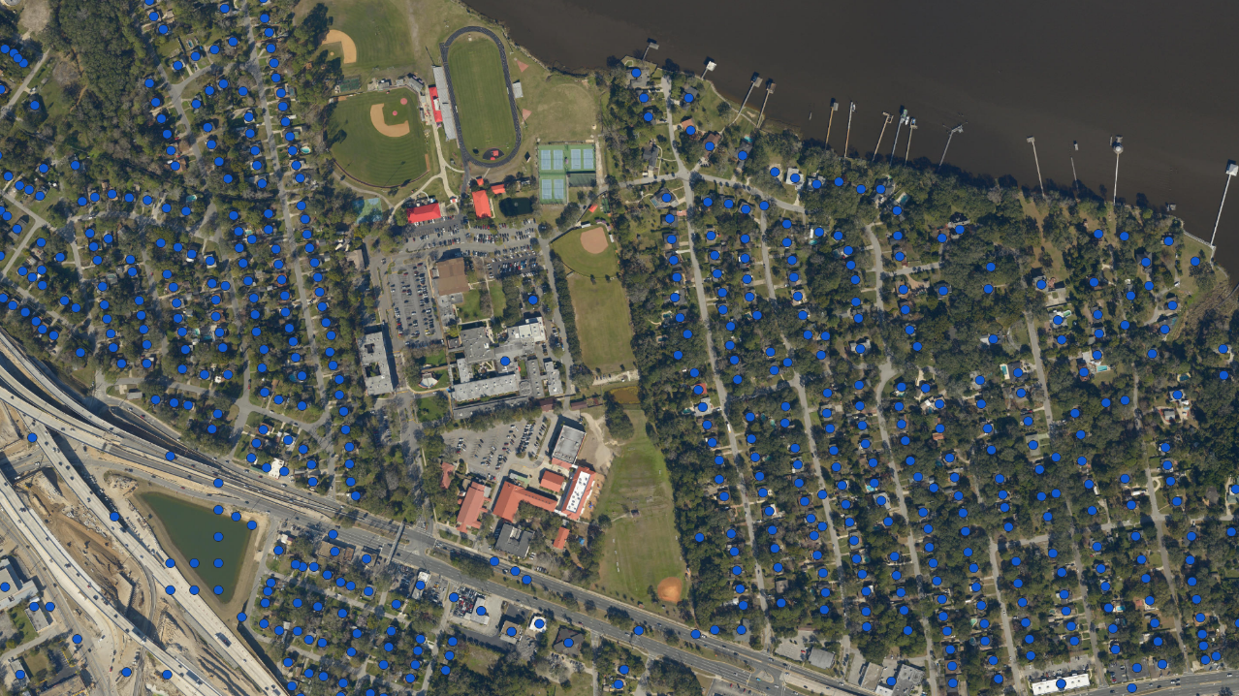
Live data for v2

Slide 21
By the Numbers

Slide 22
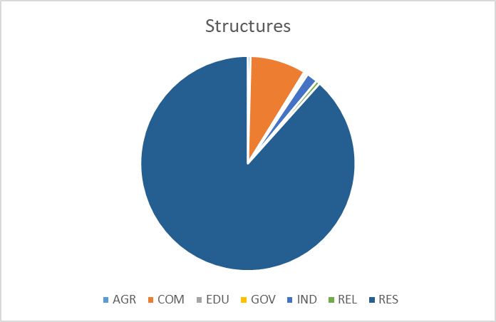
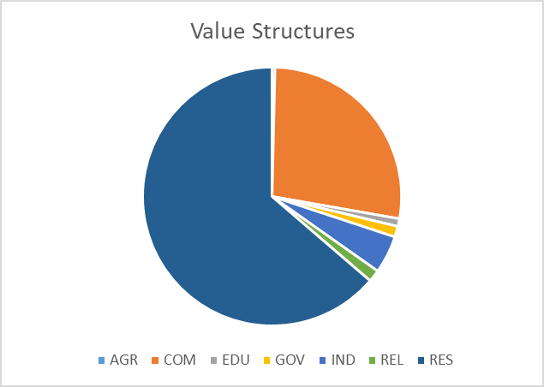
By the Numbers

Slide 23
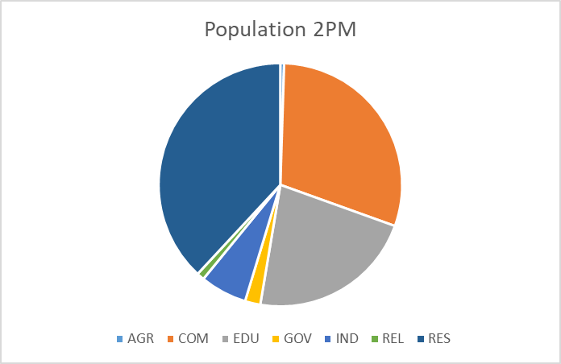
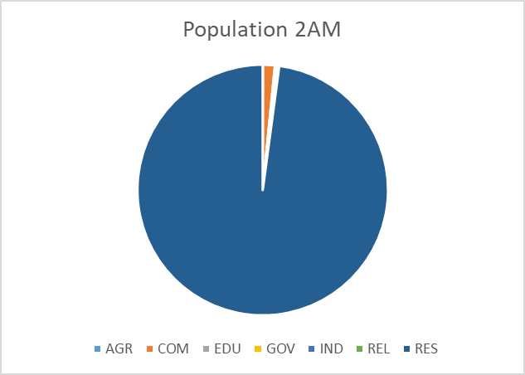
By the Numbers

Slide 24
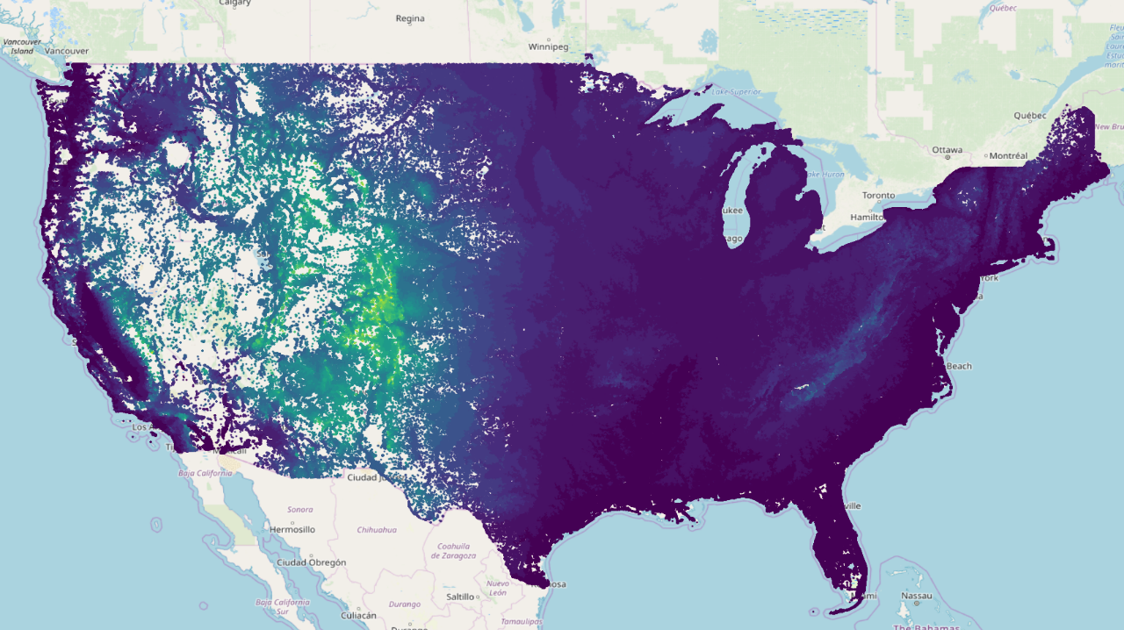
National pic by elevation

Slide 25
Data Model
Three primary considerations
Management of a continuously improving dataset
Support for additional datasets that can overlap geographically
Support for private fields and datasets

Slide 26
NSI Fields
FD_ID | A number that should be unique for all structures.
CBFips | Census Block that contains the structure.
OccType | Damage Function or Occupancy Type of the structure. This field relates the structures depth-damage relationships, number of stories, number of households, and other generic characteristics to the structure location.
YrBuilt | When available, records the parcel data assessment of the actual year built of the structure
Num_Story | Estimated number of stories the structure has.
RESUnits | Parcel informed number of residential units estimate.
Stacked | Indicates whether multiple structures were stacked on top of each other during the generation process.
Source | Indicates the main source for the original x/y and OccType data (P = Parcel, E = ESRI, N = NCES, H = HAZUS).

Slide 27
NSI Fields
X | X coordinate of each structure; it is in the Geographic Coordinate System (GCS) WGS84.
Y | Y coordinate for each structure in GCS WGS84.
EmpNum | Source estimate of number of employees at a commercial structure
Teachers | Source estimate of number of teachers at an educational structure
Students | Source estimate of number of students at an educational structure.
SqFt | Estimated total square footage for the structure.
Pop2amU65 | Population at night for the structure of people under the age of 65.
Pop2amO65 | Population at night for the structure of people over the age of 65.
Pop2pmU65 | Population during the day for the structure of people under the age of 65.
Pop2pmO65 | Population during the day for the structure of people over the age of 65.

Slide 28
NSI Fields
St_DamCat | Damage category of the structure. Damage categories are a larger aggregation than occupancy type (Res = Residential, Com = Commercial, Ind = Industrial, and Pub = Public).
Basement | Defines if the structure has a basement or not (1 or 0).
BldgType | Construction type of the structure. This is informative for structural stability criteria. From the HAZUS database this comes out of the MSH.mdb (W = Wood, H = Manufactured, S= Steel, C = Concrete, M = Masonry).
Found_Ht | Describes the foundation height of the structure in feet from the ground elevation.
Found_Type | Describes the type of foundation on the structure.
Val_Struct | Value in dollars of the structure. The analyst should document what value is represented (e.g., depreciated replacement cost, replacement cost, market value, etc.).
Val_Cont | Value in dollars of the contents of the structure.
Val_Vehic | Value in dollars of the vehicles at the structure.
Med_Yr_Blt | Describing a best estimate for the year the building was built.

Slide 29
NSI Fields
FipsEntry | Value stating estimated year that the house entered the National Flood Insurance Program.
FIRMZone | When available, states the FEMA Flood Insurance Rate Map flood zone for the strucutre.
O65Disable | The estimated disability rate for the structure among those over the age of 65.
U65Disable | The estimated disability rate for the structure among those under the age of 65.
Ground_Elv | Ground elevation (in feet) at the structure.

Slide 30
Data Sources
Location
Census
Homeland Infrastructure Foundation Level Data
Microsoft Building Footprints
Attribute
Hazus
Census
NCES
USGS

Slide 31
NSI Data Products
NLD PostgreSQL Geodatabase
File Distributions for download
Aggregate datasets
Tile datsets

Slide 32
Download the data
Static exports in geopackage format
Entire USACE NSI Base Data
USACE NSI Base Data for each district
USACE NSI Base Data for each state

Slide 33
aggregate data sets
Hexbins
Scales
500m
2500m
10000m
Improves
Performance
Communication of aggregate results

Slide 34
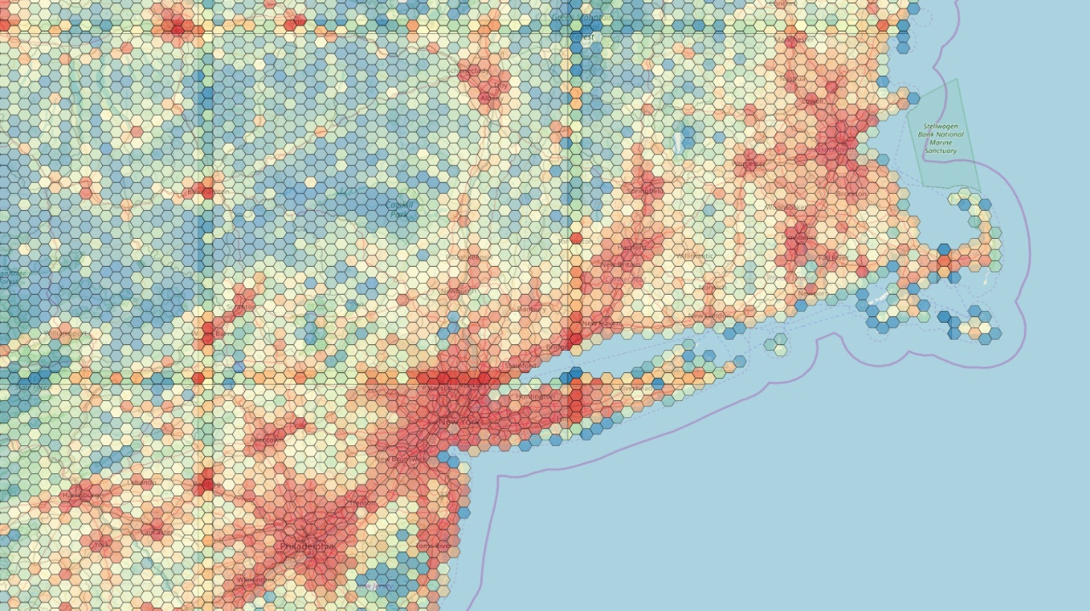
Live Hexbins Demo

Slide 35
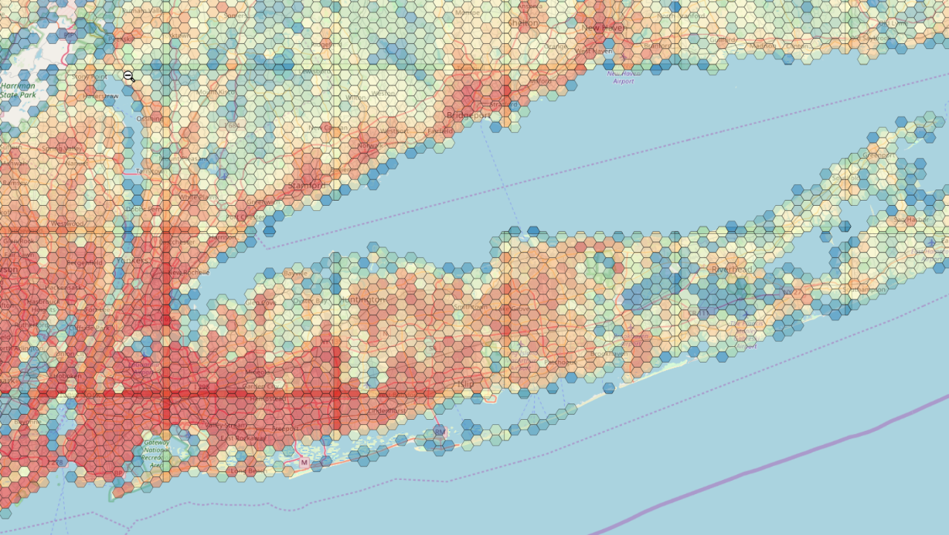
Live Hexbins Demo

Slide 36
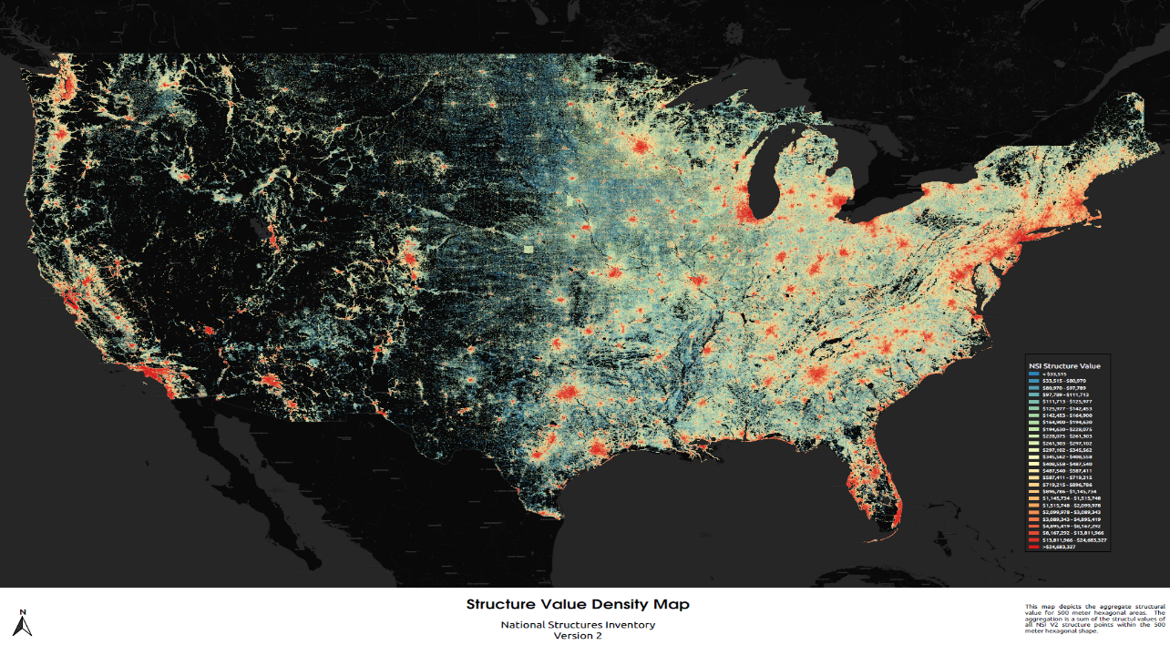
National Picture

Slide 37
Census aggregate Data Sets
State
County
Tract
Block Grp
Block

Slide 38
Streaming Services
GEOJSON/CSV (1M point limit)
Using simple polygon
Uploading a geometry (shape zip or geopackage)

Slide 39
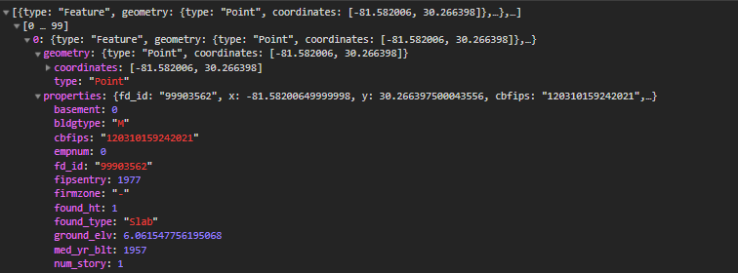
https:.../nsiapi/structures?bbox=-81.58418,30.25165,-81.58161,30.26939,-81.55898,30.26939,-81.55281,30.24998,-81.58418,30.25165

Slide 40
Services
Geopackage downloads
Using simple polygon
Uploading a geometry (shape zip or geopackage)
Workflow
Send Request
Get GUID return
Use guid to get status and eventually download

Slide 41
https:.../nsiapi/export?bbox=-81.58418,30.25165,-81.58161,30.26939,-81.55898,30.26939,-81.55281,30.24998,-81.58418,30.25165
82c81054-91fc-11e9-8c0c-0242ac110002
Processing/Complete/Error
nsi_export.gpkg

Slide 42
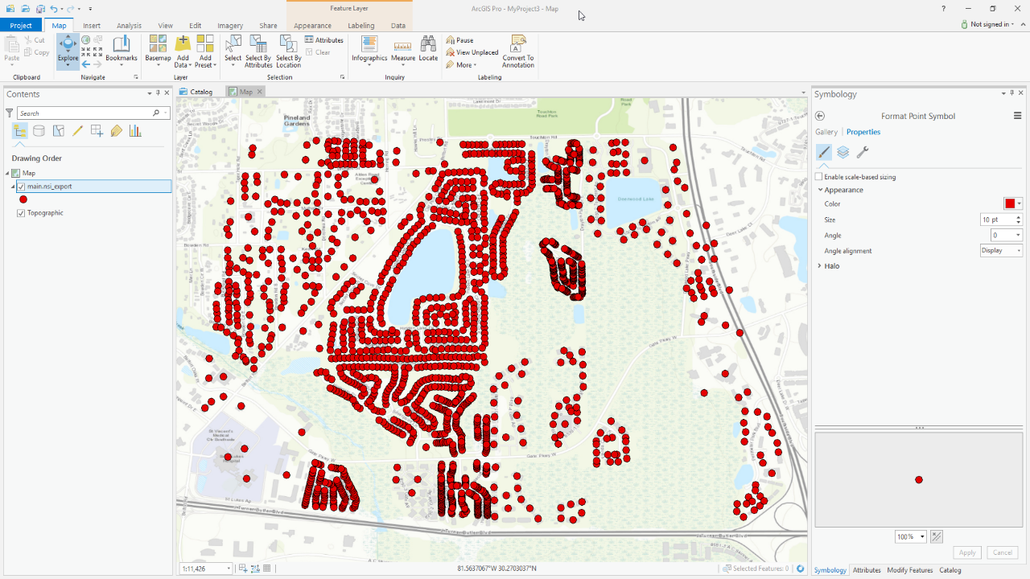

Slide 43
Services
Statistical Summary
Using simple polygon
Uploading a geometry (shape zip or geopackage)

Slide 44
Vector Tiles
NSI Points
NSI Hexbins

Slide 45
Points Vector Tiles
Two datasets using different 'dot dropping' algorithms to ensure that tiles are fast/accessible at all zoom scales
dropping occurs evenly across a tile (rural and urban areas are thinned by same ratio)
dropping is based on proximity to other points, so urban areas are thinned much more than rural areas

Slide 46
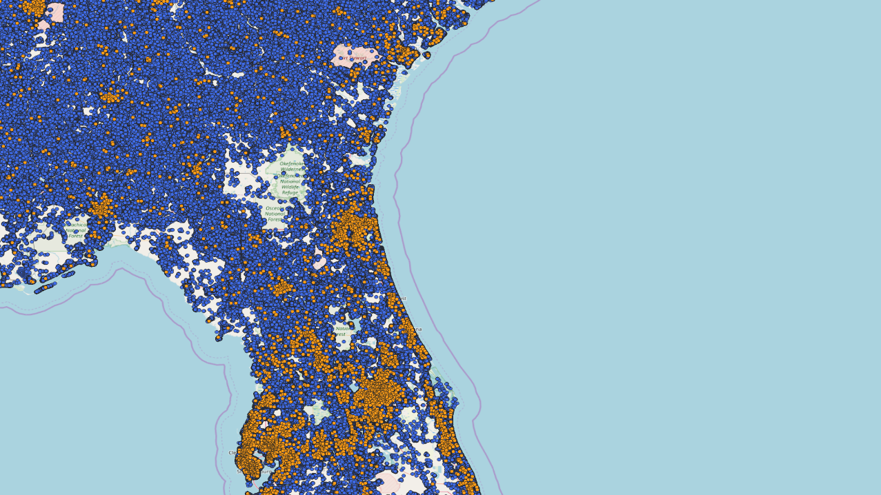
Vector tiles service demo

Slide 47
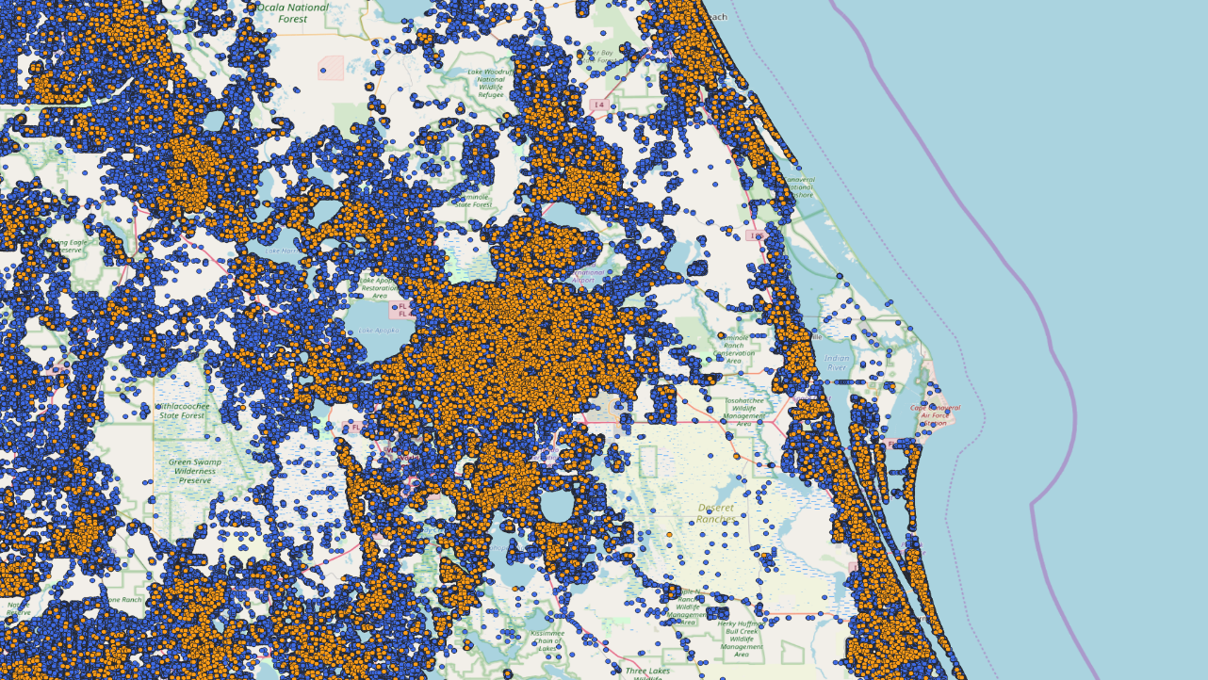
Vector tiles service demo

Slide 48
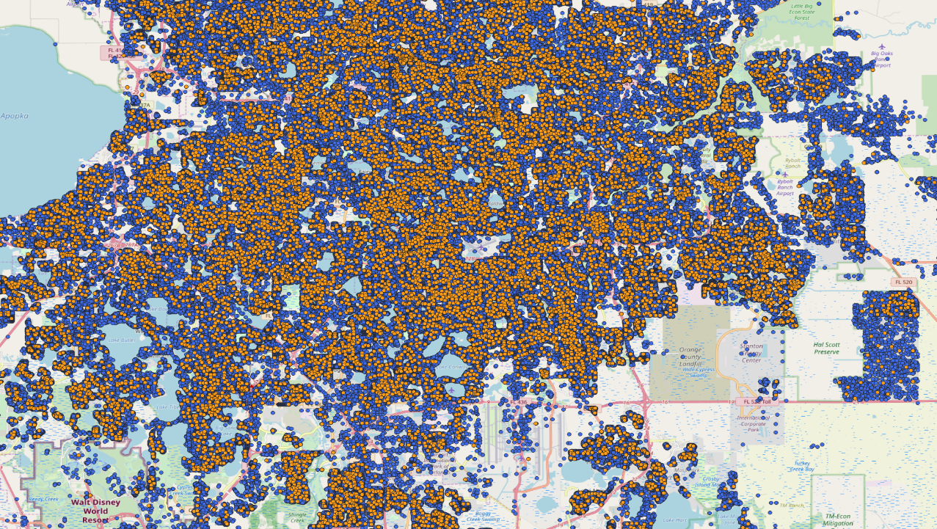
Vector tiles service demo

Slide 49
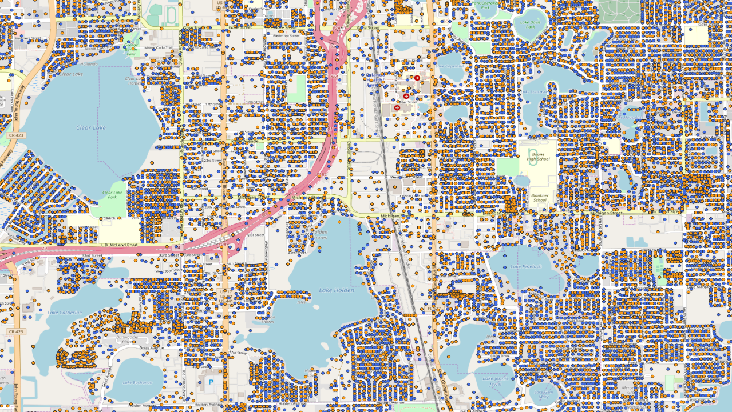
Vector tiles service demo

Slide 50
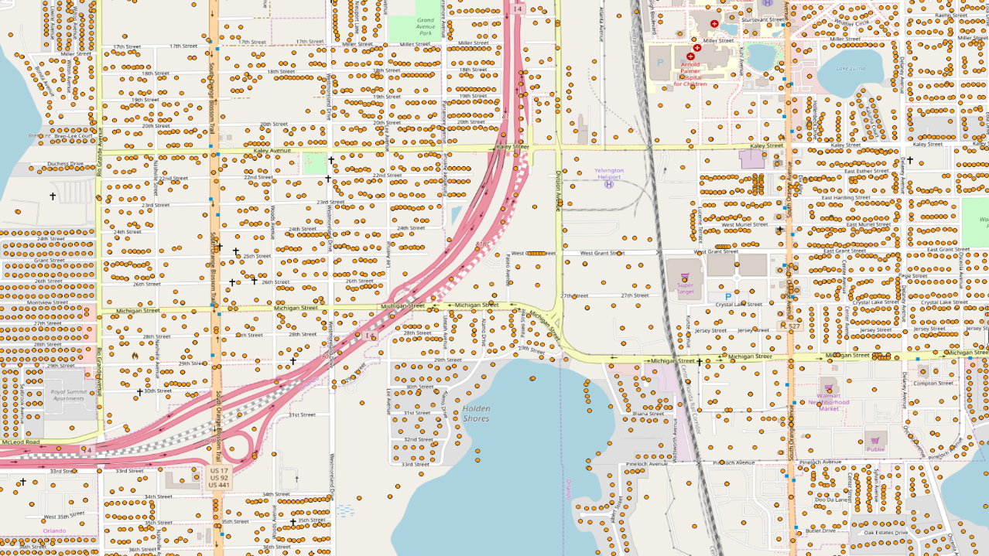
Vector tiles service demo

Slide 51
Current State
Data processed and loaded into PostgreSQL in DEV
National/State geopackage exports created
District geopackage exports pending
Hexbin vector tiles created but might need additional simplification
Services deployed to DEV and being tested

Slide 52
Work In Progress
Migration to NLD Production database
Migrate services to production
ESRI Services Testing
ArcGIS Server
ESRI Koop project
Deploy vector tiles for:
NSI Points
Hexbins
Development of web clients to access the data and services

Slide 53
Next FY
API and application support for other structure inventories

Slide 54
Questions?

